Slide 1
Reception’s Maths lesson WB 18th January 2021
LO: I can compare the mass and capacity of everyday things .
Please send all completed work to pjones@kingsavenue.lambeth.sch.uk

Slide 2


Monday’s activity
Today we are going to talk about comparing the mass of things.
How do we compare mass?
We compare mass by measuring the weight of things by talking about ow heavy or light things are.
Ask the children to be human balance scales – place an item on each hand and ask them to tip to show which item is heavier and which is lighter. Use the balance scales to check the children’s estimations. The children could also hold buckets or bags in each hand and place items inside to feel which has the stronger downward pull.
Can you compare the weights of these two objects? Look around your house and find things which feel heavier and lighter than a pencil, then sort them into 2 groups.
Feather
Pencil

Slide 3

Tuesday’s activity
Encourage the children to compare the weight of different size balls and different things in the house/ classroom. To provide further interest, encourage the children to use different parcels to balance a book on a scale.
Can they find the heaviest parcel? Can they find the lightest? Are larger parcels always heavier?
Use the link to help you compare mass: https://youtu.be/zkayMXH5QlU

Slide 4
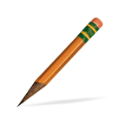
Tuesday’s activity
How many cubes does it take to balance the scales?

Slide 5

Wednesday’s activity- exploring capacity ?
Capacity is the amount that something can contain.
With family / in a small group perhaps during snack time, provide each child with a cup. Ask them to make their cup full, make it empty, nearly full, nearly empty, about half full. Can they find a container which holds more than their cup? Can they find one which holds less? Provide a selection of containers of different shapes and sizes and ask the children to investigate which holds the most. They may do this by pouring directly from one container to another. They could also use a small cup to fill each container, counting how many small cup-full the containers hold. Encourage them to record their results using their own methods of recording.
Can you draw a container that is nearly empty and full? How do you know?

Slide 6
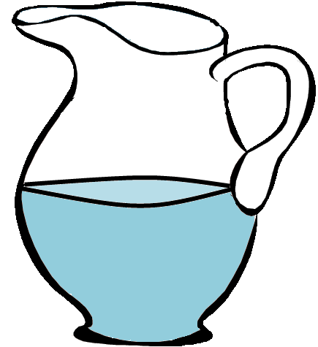
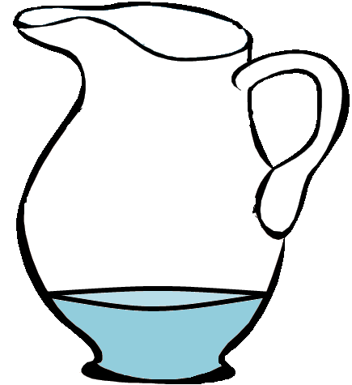
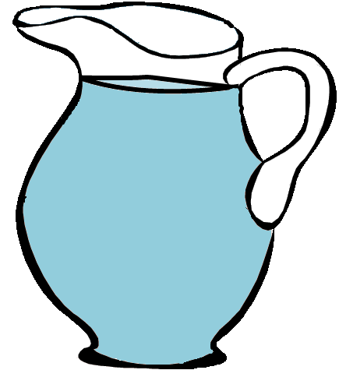
Thursday’s activity -Let’s Try Together!
Set up a café or picnic area providing a variety of jugs and beakers. Encourage the ‘waiters’ to take drinks orders and bring out the drinks. Play alongside the children to model the language of nearly full, half full, nearly empty etc and enjoy your delicious drinks! (Discuss why we don’t want the cups to be absolutely full!)

Slide 7
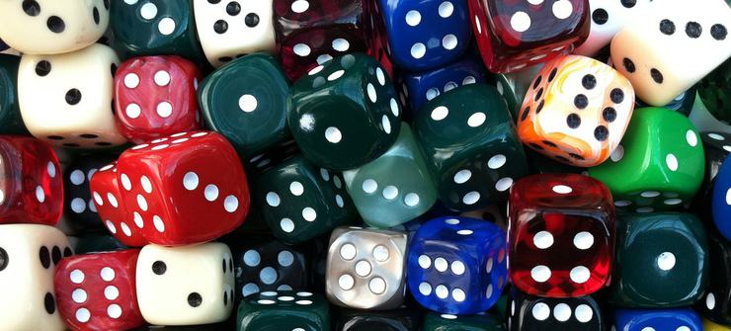
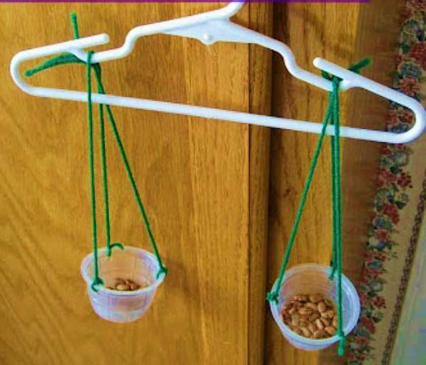
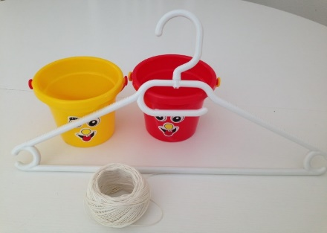
Friday’s activity - Consolidation
Explore how to balance 5 dice for example by putting the 5 piece on one side of the scale and exploring different combinations to make it balance. How many different ways can they find to balance 5? What other combinations of dice balance?
Q: What happens if you put a 5 piece on one side of the scale and two 3 pieces on the other? How many ways can you find to balance 5 exactly?

Slide 8
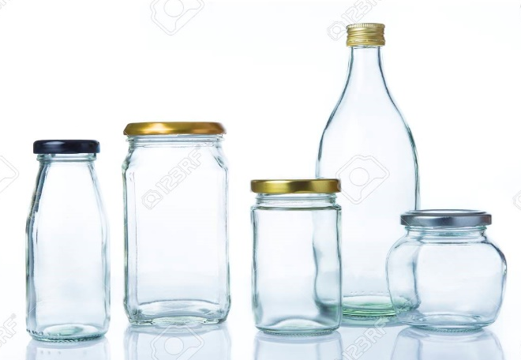


Friday –Consolidation
Which Holds More?
Provide a tall narrow container and a wide shallow one. Ask the children to predict which will hold more water? How could they check? Encourage the children to try different methods. More containers could be added and the children asked to order them from smallest capacity to largest.

