Slide 1
Friday 15th May 2020 Year 1 English Lesson LO: To use creative adjectives in a narrative. Miss James’ email address: hjames@kingsavenue.Lambeth.sch.uk

Slide 2
An adjective is a word that describes a noun. A noun is a person, place or thing.
The sparkly river carried the log through the forest.
Sparkly is the adjective describing the river which is the noun.

Slide 3
Fill in the gaps with the correct adjectives.
happy powerful beautiful impressed terrified

Slide 4
You will write a story about Billy in the book ‘The Boy Who Hated Toothbrushes’ finding the letter from the tooth fairy and beginning to brush his teeth. Try to include lots of creative adjectives. Read the example beginning on the next slide three times aloud. When you see an adjective, smile.

Slide 5
Billy’s rotten tooth wobbled continuously in his mouth. He pulled it and pushed it. Then all of a sudden, the old tooth detached itself from Billy’s tender gum. Billy held it in his hand.
‘MUM! MY TOOTH CAME OUT!’ Billy shouted surprised.
‘That’s lovely dear!’ Billy’s mum exclaimed.
The proud lady explained to Billy that he should wrap the delicate tooth in some clean tissue and wash his mouth out with clean water. Afterwards, Billy put the tooth under his pillow so it could be found by the mysterious tooth fairy. This was Billy’s first fallen tooth. He was amazed to hear that the tooth fairy would come at night time and replace his tooth for some money.

Slide 6
Success Criteria
Capital letters at the beginning of sentences and for names of people, places, days and months.
Full stops at the end of sentences.
Finger spaces between words.
Lots of creative adjectives.
Include exclamations.
Black –everyone must do.
Red- trickiest challenge.

Slide 7
Now you may begin. Use the word mats on slide 7 and 8 to help you.

Slide 8
rotten tooth wobbled continuously mouth pulled pushed all of a sudden old tooth detached tender gum.
shouted surprised.
lovely exclaimed.
proud lady explained should wrap delicate tooth clean tissue wash mouth clean water. Afterwards pillow found by mysterious tooth fairy. first fallen tooth. amazed tooth fairy night time replace money.

Slide 9
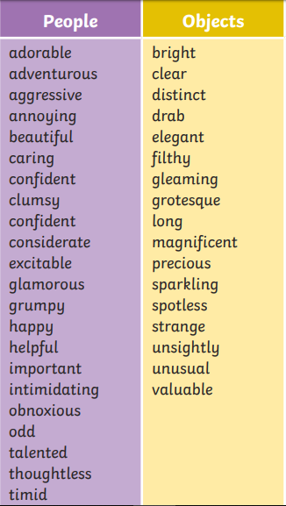
Adjectives

Slide 10
Need a more accessible challenge? Fill in the gaps with the correct adjectives.
Billy’s_______tooth wobbled continuously in his mouth.
The _______ tooth detached itself from Billy’s tender gum.
‘MUM! MY TOOTH CAME OUT!’ Billy shouted ________.
Billy that he should wrap the delicate tooth in some ______tissue.
the ________ tooth fairy came at night.
Billy’s mum was ______ of Billy.
mysterious old clean rotten proud surprised

