Slide 1
Wednesday 6th May 2020 Reception Phonics lesson ‘ar’ sound
‘Start the car’

Slide 2
Click the following link to recap the sounds that we have learnt so far:
https://www.youtube.com/watch?v=s6OiU2h3sUI&app=desktop
Alternatively, search the video title: RWI Pure Sounds

Slide 3
Click the link below to watch the video. Alternatively, search the actual video title on Youtube: Phonics set 2 – ‘ar’ sound
https://youtu.be/8vAAxD-53q0

Slide 4
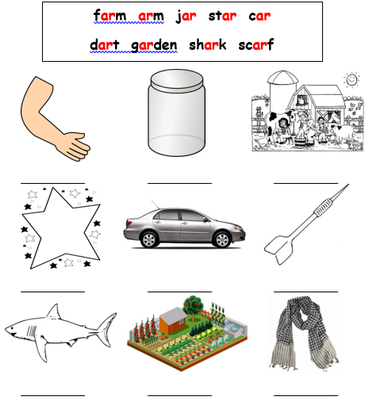
Label each picture with the correct ‘ar’ word.

Slide 5
Now write down 5 alien ‘ar’ words that you can think of.

Slide 6
Can you make a sentence using this red /tricky word?
was

