Slide 1
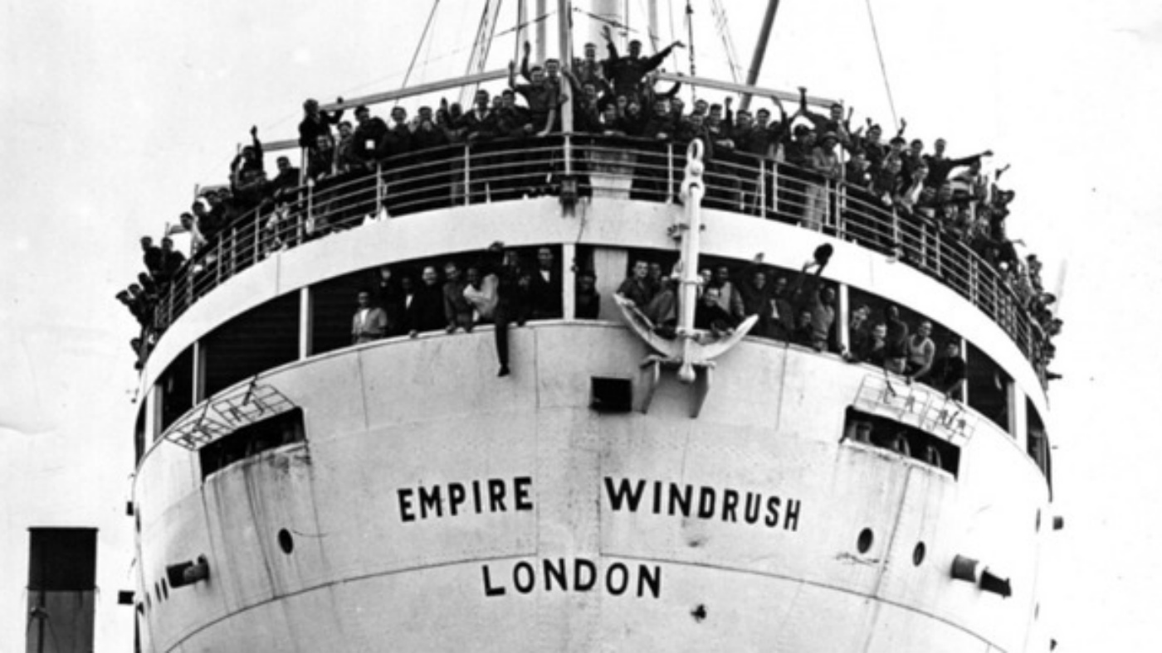
WINDRUSH
Lesson 3
I can explain what the Windrush was.

Slide 2
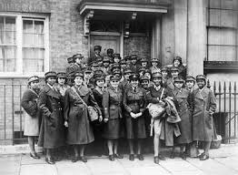
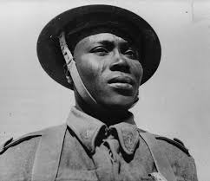
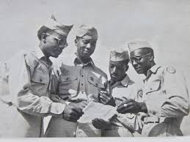
Britain in 1948
Many Commonwealth citizens had fought for Britain during the war and many had lost their lives. They had shown how important they were to the British Empire.
In 1948, the British Nationality Act gave 800 million people in the Commonwealth the right to claim British citizenship.
Britain needed workers since many men had died in World War II.
The NHS was launched in 1948 and needed labour and constantly advertised in Commonwealth countries to attract new workers.

Slide 3
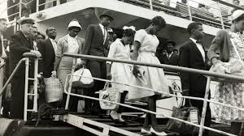
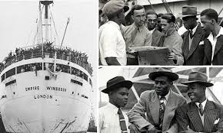
On Wednesday June 23, 1948, The Times newspaper reported the arrival of the Empire
Windrush under the headline ‘Jamaicans
arrive to seek work.’ It said: ‘Of the 492 Jamaicans who arrived at Tilbury on Monday to seek work in this country, 236 were housed last night
in Clapham South Deep Shelter. The remainder had
friends to whom they could go and prospects of work. The men had arrived at Tilbury in the ex-troopship Empire Windrush. Among them are singers, students, pianists, boxers and a complete dance band. Thirty or forty had already volunteered to work as miners.
The Empire Windrush has become the symbol of post-war
mass migration and her Caribbean passengers regarded as the ‘pioneers’ who laid the foundation for the generation of settlers in the years that followed. Many of those who landed on 22 June 1948 were RAF servicemen who returned to help rebuild Britain after WWII. Other passengers later enrolled for further public service; some of the women were recruited by the National Health Service after July 1948.

Slide 4
Windrush Passenger
List

Slide 5
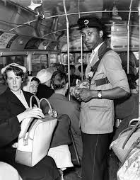
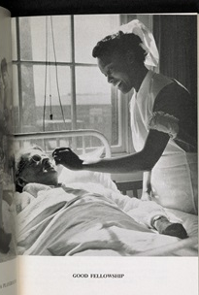
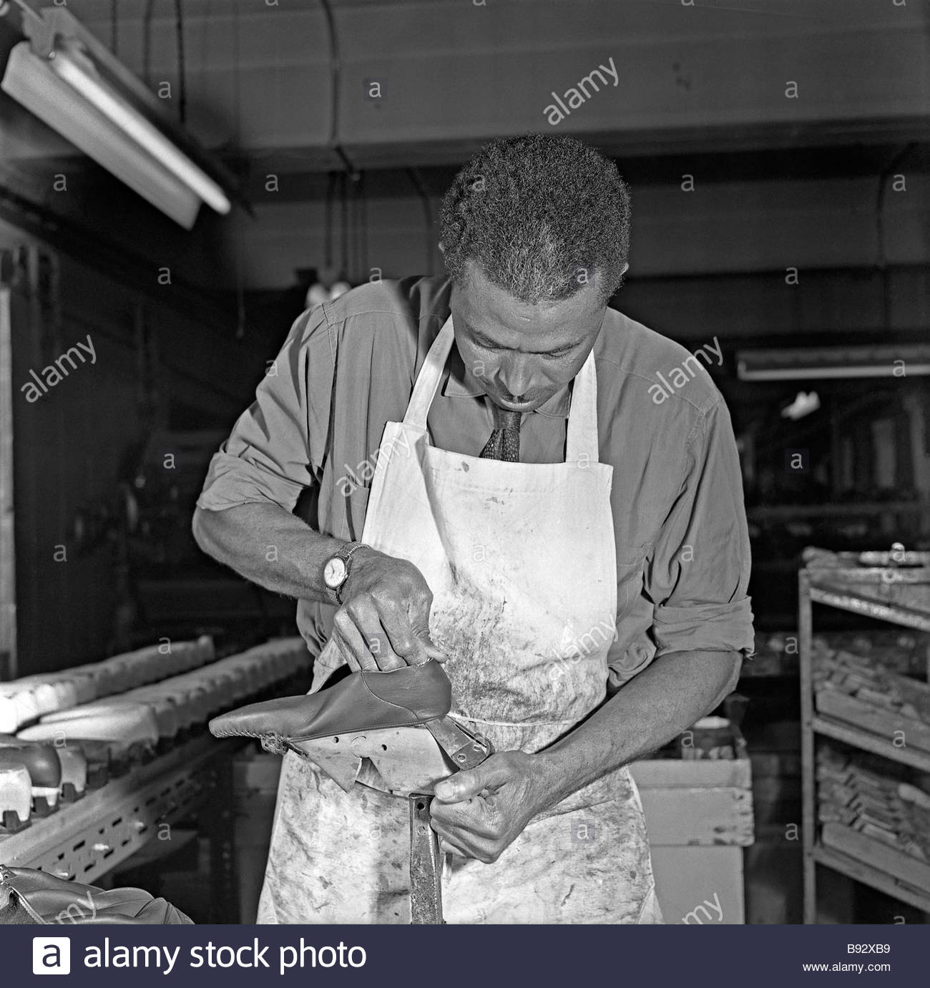
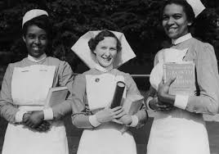
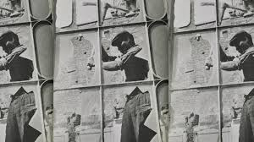
Jobs for the Windrush
The most common sectors in which people from the Caribbean found jobs included, for men, manufacturing and construction, as well as public transport.
So what did these early migrants from Jamaica, Barbados, Trinidad and other Caribbean countries that were then part of the British Empire, do in the UK when they came to what they saw as ‘the Mother Country’?
Many Caribbean women found employment in the NHS as nurses and nursing aides, as well as in public transport and in manufacturing, especially in the growing white goods industries in cities.

Slide 6
Activity-
Answer the 7 questions on the passengers list of the Windrush
Write about What was it like to emigrate to Britain in 1948?
Use all the resources to help you.

Slide 7
Resources- copy the links to your browser
Windrush: Who exactly was on board?
https://www.bbc.co.uk/news/uk-43808007
Advice for the Windrush generation on what to do next
https://www.bbc.co.uk/news/uk-43823632
Windrush generation: Who are they and why are they facing problems?
https://www.bbc.co.uk/news/uk-43782241
Arrival of HMT Empire Windrush
https://youtu.be/QDH4IBeZF-M
Lord Kitchener - London Is Good Place For
https://youtu.be/su6yNdw5wYo

